Slide 1



Another way to test your microservices
by Gwendal Leclerc
Jun 30th, 2023

Slide 2

Domain Team @ OVHcloud
> 5M of domain names
K8s along with some VMs
70% Go / 30% Perl
API Gateway HTTP

Slide 3


Slide 4
Problematics?
Dependence between micro-services
Several Databases
Not easy to start
Not easy to test in integration

Slide 5


Slide 6


How can we test our microservices?

Slide 7
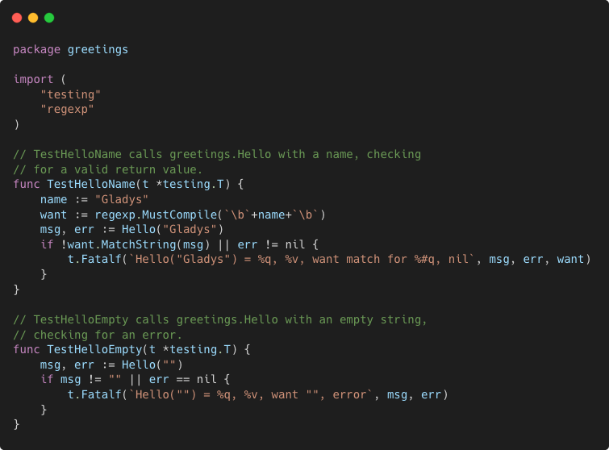
White box testing
Very related to the code
Allows you to test pieces of code
In the same language as the code
Junit
Go test
Jest
….

Slide 8
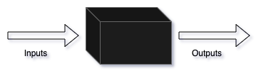
Black box testing
The code is not known
Based on inputs and outputs
Language agnostic

Slide 9
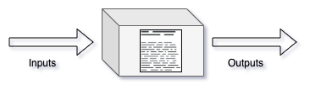
Gray box testing
Still Based on inputs and outputs
But code driven
Could be language agnostic or not

Slide 10
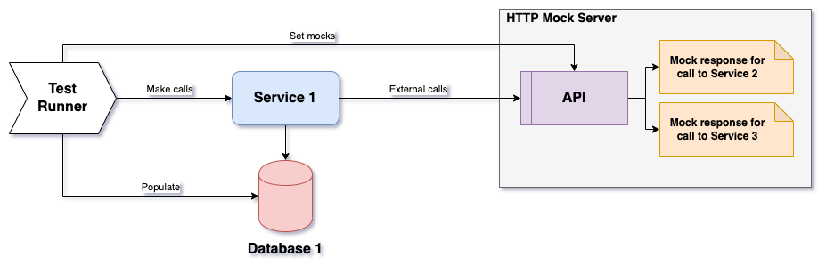
1. Isolated service tests

Slide 11
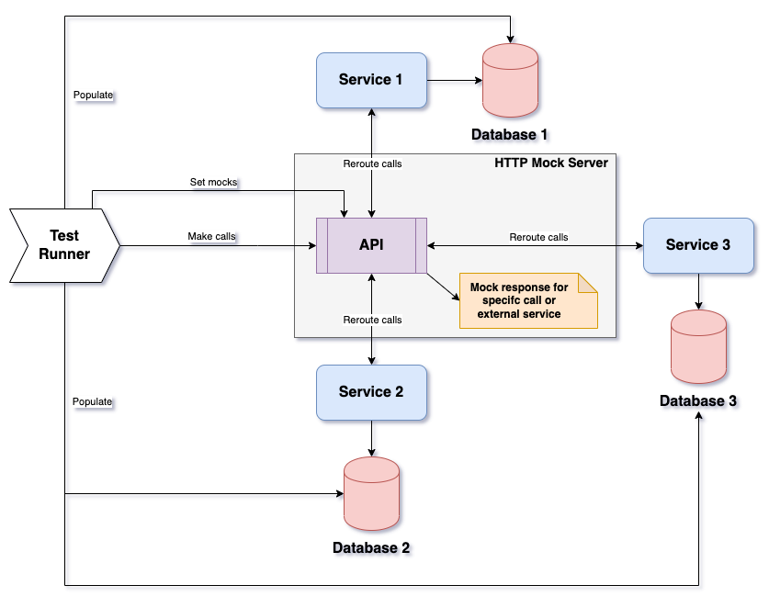
2. Integration tests

Slide 12


Using what?

Slide 13


Manage dependencies
Docker / Docker Compose
K8s / Helm
… whatever you want

Slide 14
Venom
Declarative integration testing tool
Developed @ OVHcloud (https://github.com/ovh/venom)
It can
Make HTTPs calls
Execute scripts
Manipulate Databases
Make assertions
And more...
🐍

Slide 15
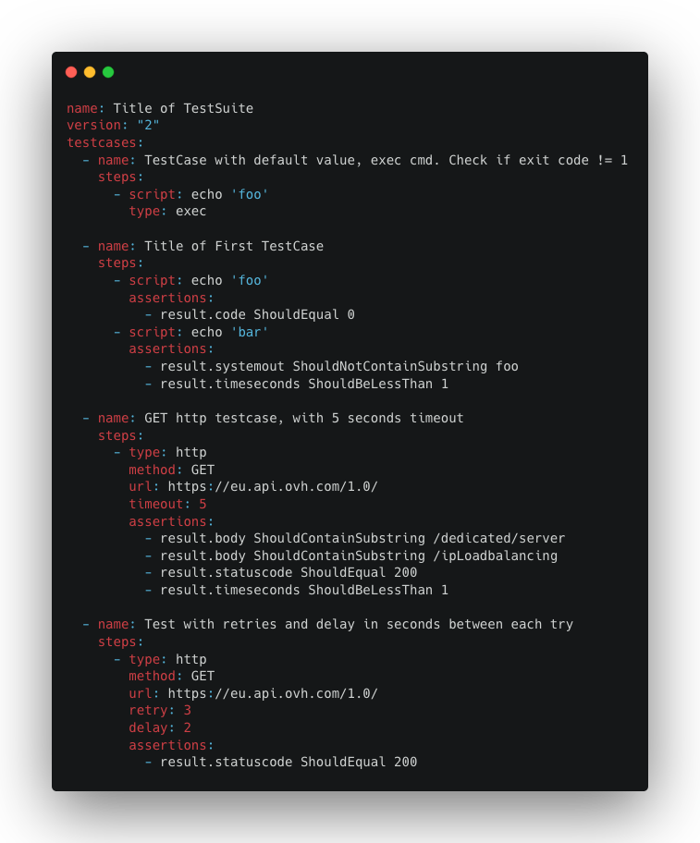
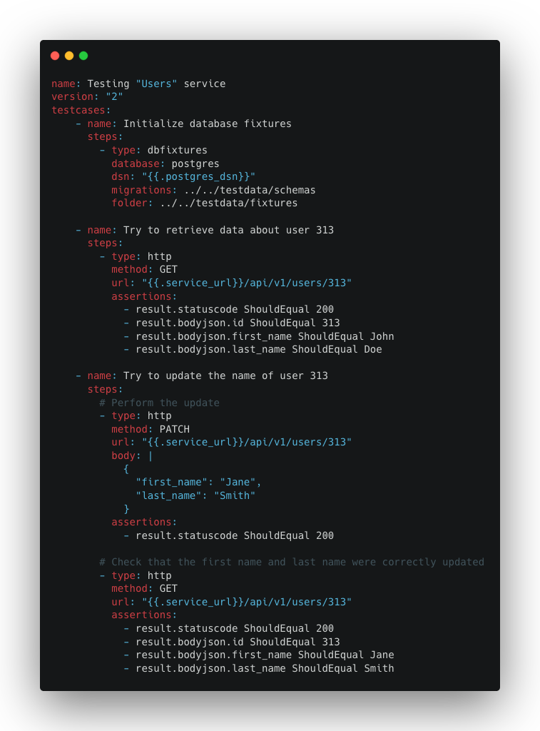

Slide 16

Smocker
Declarative HTTP mock server
Developed by Thibaut Rousseau and Gwendal Leclerc
https://github.com/Thiht/smocker
It can
Mock HTTP calls
Proxify HTTP requests
Make assertions on mocks
Display what happened through an UI
And more...

Slide 17
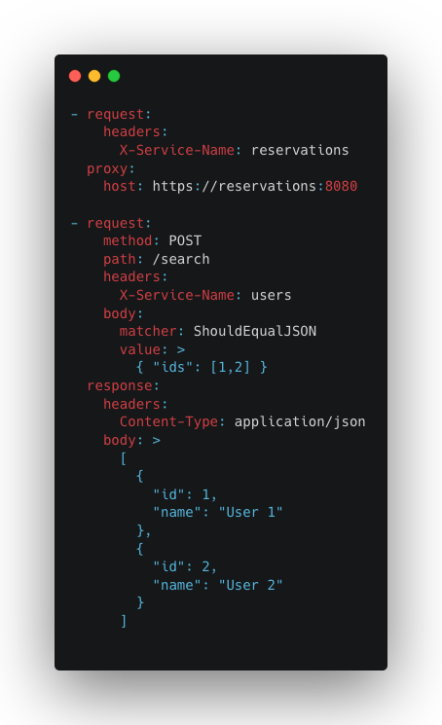
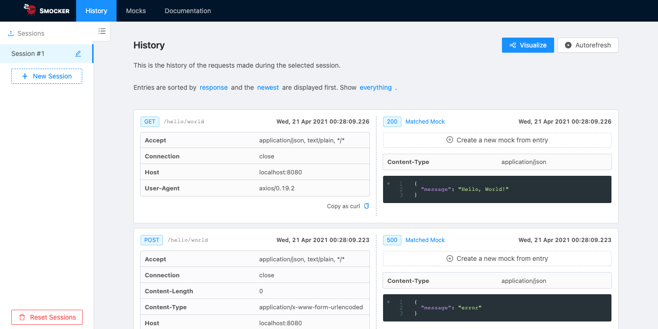

Slide 18

Let’s go live

Slide 19
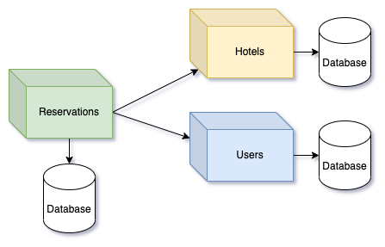
Demo: Hotel reservation service

Slide 20
Links to go further
https://blog.ovhcloud.com/declarative-integration-tests-in-a-microservice-environment/
https://smocker.dev/
https://github.com/ovh/venom
https://github.com/Thiht/smocker
https://github.com/gwleclerc/venom_smocker_example

Slide 21





Find me online :
@Skillo1989
Gwendal Leclerc
gwleclerc

